Slide 1
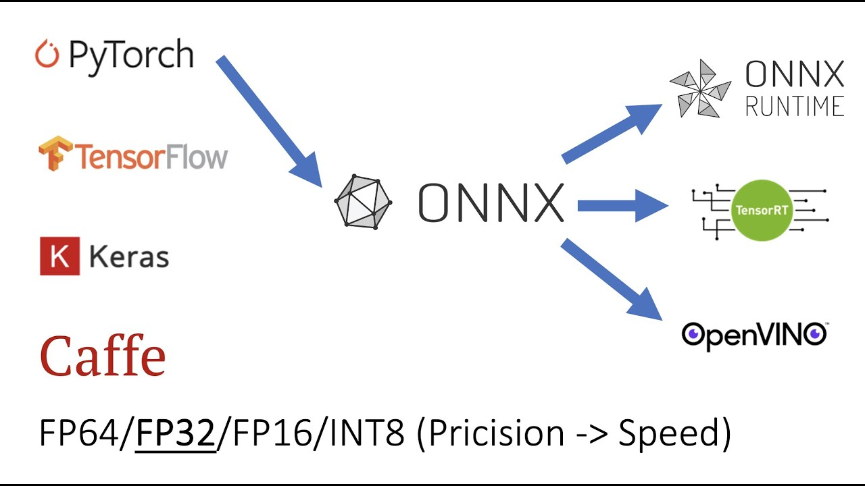
Model Deployment (Conversion Pytorch to TensorRT through ONNX Pipeline)
Arnav Sinha

Slide 2
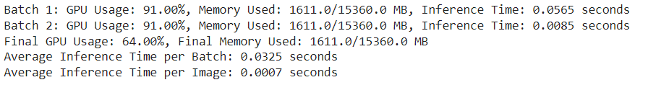
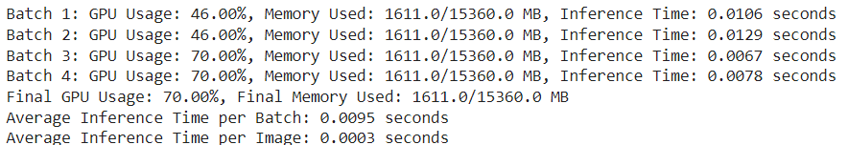
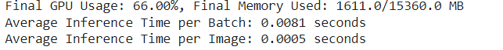

Pytorch (GPU Usage, Memory Usage, Inference Time)
Batch Size = 50
Batch Size = 32
Batch Size = 16
Inference per sample
Arnav Sinha

Slide 3
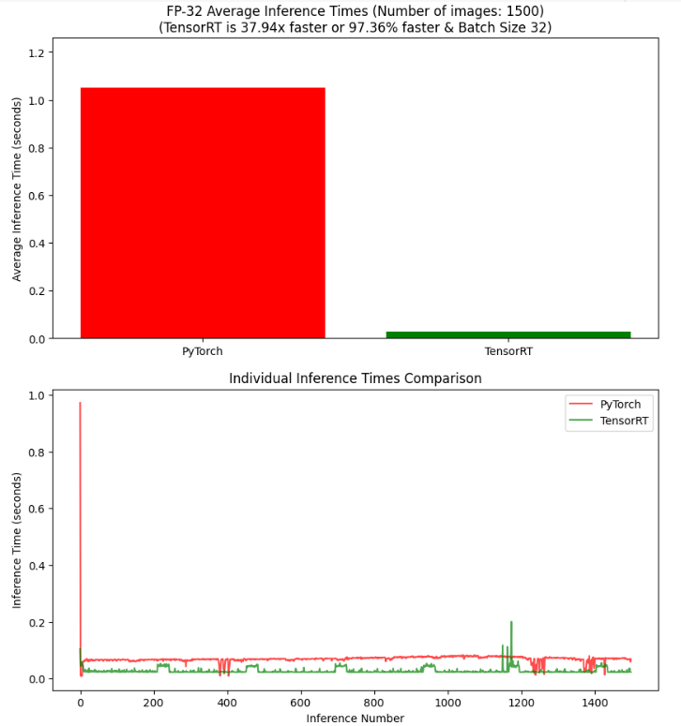

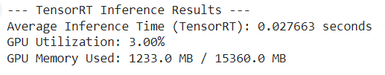
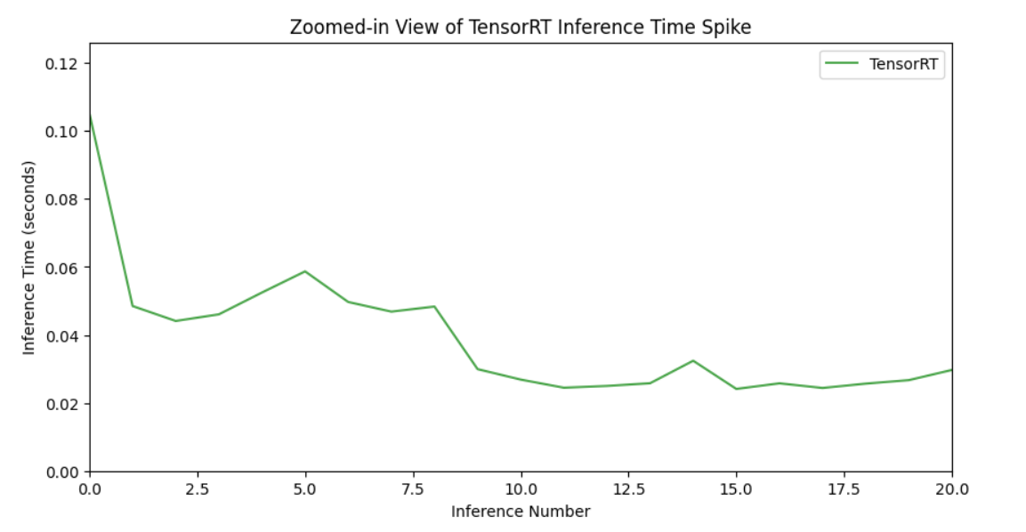
TensorRT (GPU Usage, Memory Usage, Inference Time)
Precision: FP32 Batch Size = 32
Arnav Sinha

Slide 4
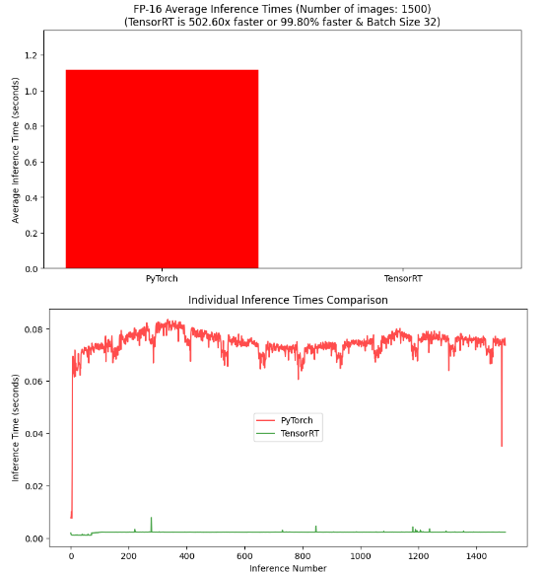



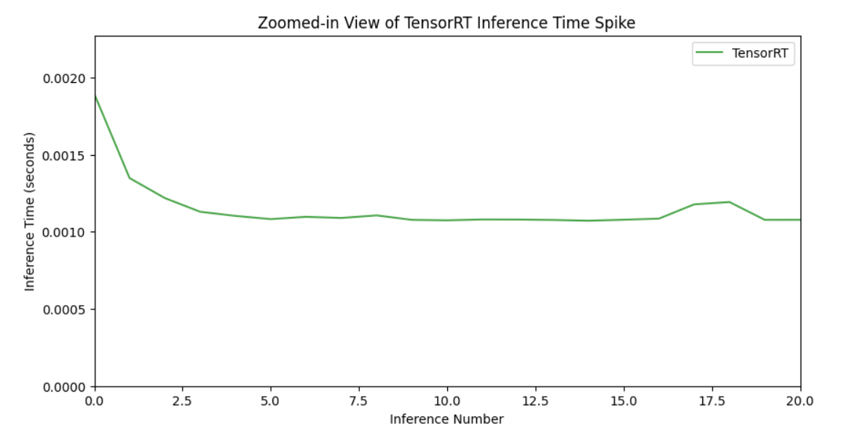
TensorRT (GPU Usage, Memory Usage, Inference Time)
Precision: FP16 Batch Size = 32
Arnav Sinha

Slide 5
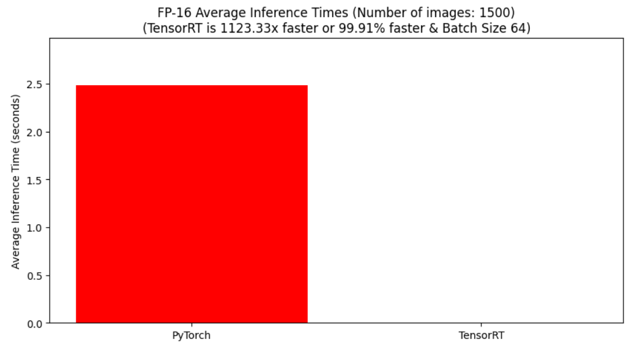


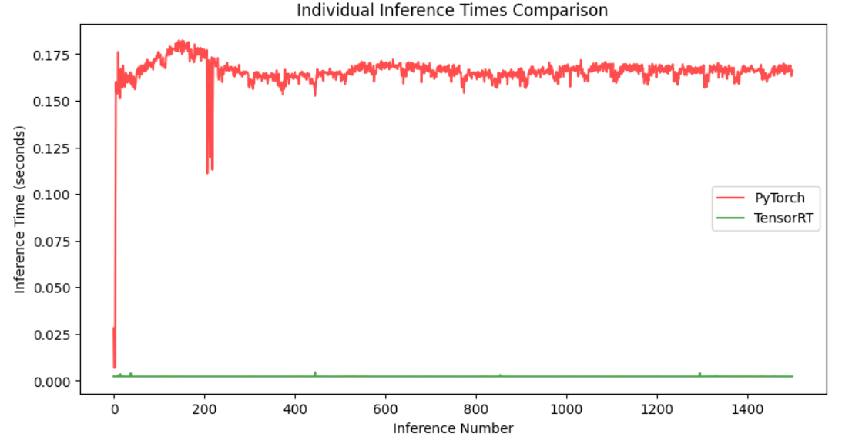
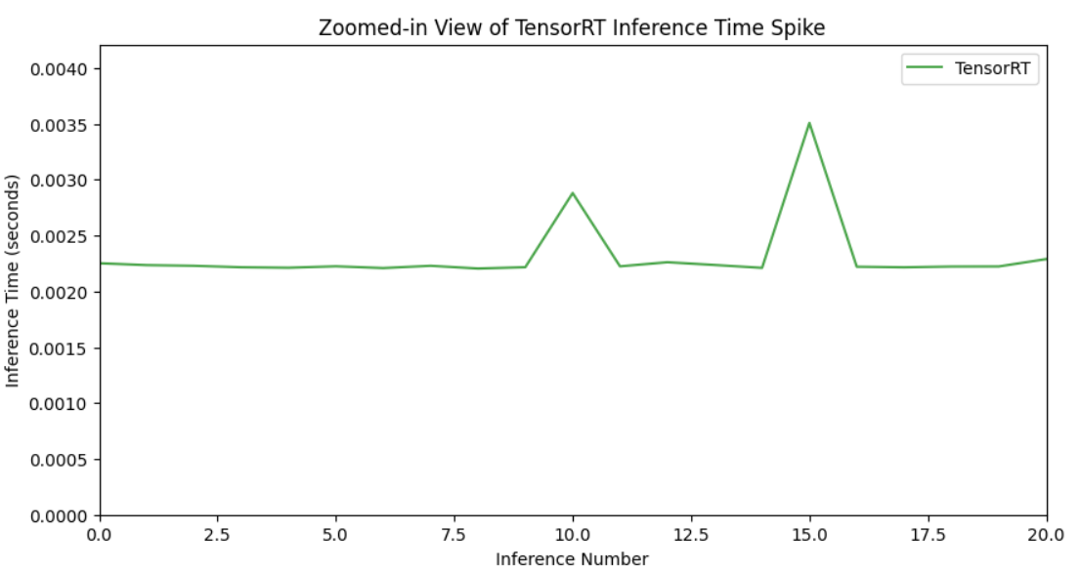
TensorRT (GPU Usage, Memory Usage, Inference Time)
Precision: FP16 Batch Size = 64
Arnav Sinha

Slide 6
